Slide 1
Task 1: Identifying the Top Branch by Sales Growth Rate
branch | month | growth_rate
A | 2019-03 | 26.12%
branch | month | growth_rate
A | 2019-03 | 26%
C | 2019-03 | 13%
B | 2019-03 | 1%
B | 2019-02 | -7%
C | 2019-02 | -19%
A | 2019-02 | -23%
SQL Query :
WITH MonthlySales AS (
SELECT branch, DATE_FORMAT(date, '%Y-%m') AS month, SUM(total) AS sales
FROM walmart_sales
GROUP BY branch, month
),
GrowthCalc AS (
SELECT branch, month, sales,
LAG(sales) OVER (PARTITION BY branch ORDER BY month) AS prev_month_sales
FROM MonthlySales
),
GrowthRates AS (
SELECT branch, month, sales, prev_month_sales,
ROUND(((sales - prev_month_sales) / prev_month_sales) * 100, 2) AS growth_rate
FROM GrowthCalc
WHERE prev_month_sales IS NOT NULL
)
SELECT branch, month, growth_rate
FROM GrowthRates
ORDER BY growth_rate DESC
LIMIT 1;

Slide 2
Task 2: Finding the Most Profitable Product Line for Each Branch
branch | most_profitable_product_line | total_profit
C | Food and beverages | 1131.78
A | Home and lifestyle | 1067.50
B | Sports and travel | 951.88
l-- Step 1: Calculate total profit for each product line in each branch
SELECT
branch,
product_line,
SUM(gross_income) AS total_profit -- gross_income = profit
FROM walmart_sales
GROUP BY branch, product_line;
-- Step 2: Find the most profitable product line per branch
WITH ProfitPerLine AS (
SELECT
branch,
product_line,
SUM(gross_income) AS total_profit
FROM walmart_sales
GROUP BY branch, product_line
),
RankedProfit AS (
SELECT
branch,
product_line,
total_profit,
RANK() OVER (PARTITION BY branch ORDER BY total_profit DESC) AS profit_rank
FROM ProfitPerLine
)
-- Step 3: Select only the top product line per branch
SELECT
branch,
product_line AS most_profitable_product_line,
total_profit
FROM RankedProfit
WHERE profit_rank = 1;

Slide 3
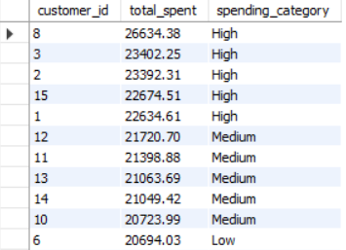
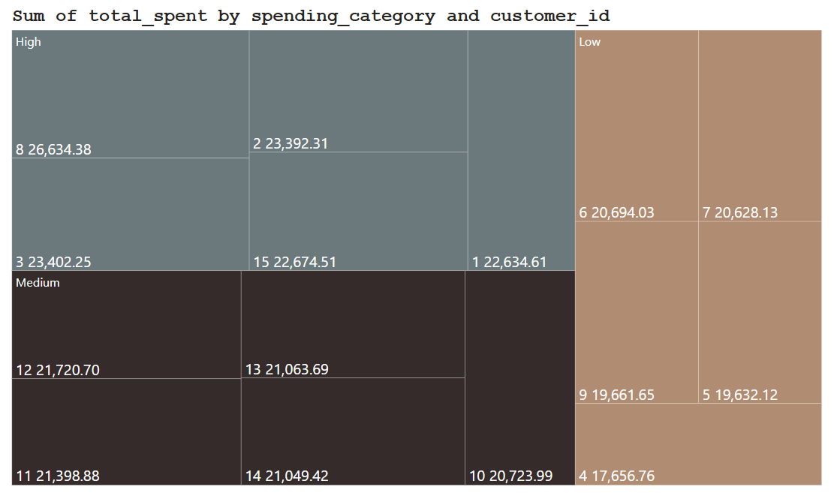
Task 3: Analyzing Customer Segmentation Based on Spending
SQL query:
WITH CustomerSpending AS (
SELECT customer id, SUM(total) AS total_spent
FROM walmart_sales
GROUP BY customer id
),
RankedSpending AS (
SELECT customer id, total_spent,
NTILE(3) OVER (ORDER BY total_spent DESC) AS spending_tier
FROM CustomerSpending
)
SELECT customer id, total_spent,
CASE WHEN spending_tier = 1 THEN 'High'
WHEN spending_tier = 2 THEN 'Medium'
ELSE 'Low' END AS spending_category
FROM RankedSpending;

Slide 4
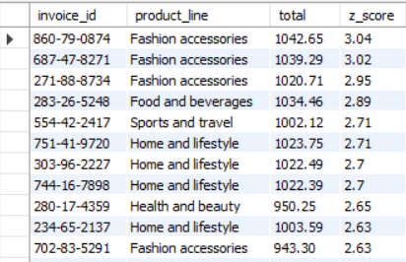
Task 4: Detecting Anomalies in Sales Transactions
SQL Query
WITH ProductStats AS (
SELECT product_line, AVG(total) AS avg_total, STDDEV(total) AS std_total
FROM walmart_sales
GROUP BY product_line
),
TransactionZScores AS (
SELECT invoice_id, product_line, total,
(total - avg_total) / std_total AS z_score
FROM walmart_sales JOIN ProductStats USING(product_line)
)
SELECT invoice_id, product_line, total, z_score
FROM TransactionZScores
WHERE ABS(z_score) > 2;

Slide 5
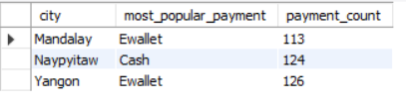
Task 5: Most Popular Payment Method by City
SQL Query
WITH PaymentCounts AS (
SELECT city, payment, COUNT(*) AS payment_count
FROM walmart_sales
GROUP BY city, payment
),
RankedPayments AS (
SELECT city, payment, payment_count,
RANK() OVER (PARTITION BY city ORDER BY payment_count DESC) AS payment_rank
FROM PaymentCounts
)
SELECT city, payment AS most_popular_payment, payment_count
FROM RankedPayments
WHERE payment_rank = 1;

Slide 6
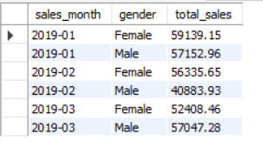
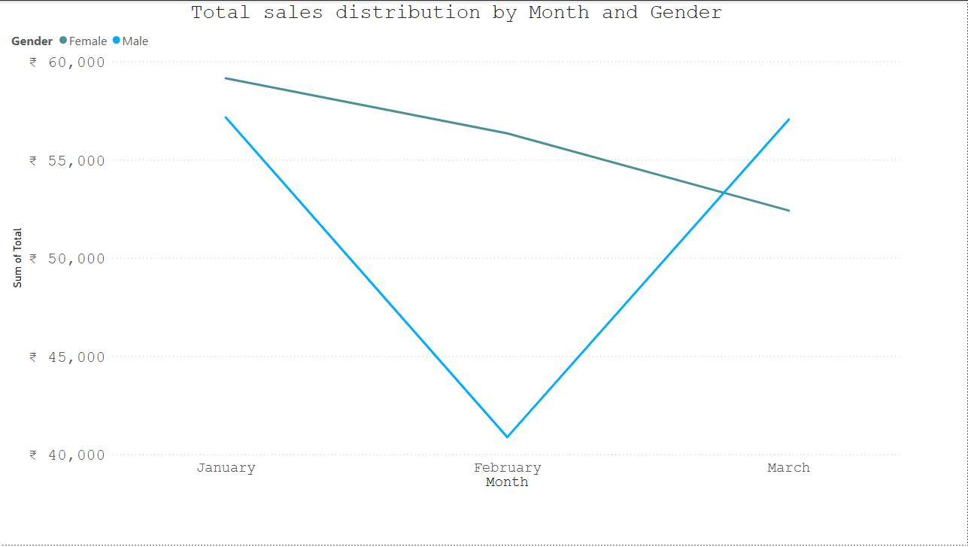
Task 6: Monthly Sales Distribution by Gender
SQL Query
-- Step 1: Extract the month from the date and group by gender
SELECT
DATE_FORMAT(date, '%Y-%m') AS sales_month, -- Formats date as 'YYYY-MM'
gender,
ROUND(SUM(total), 2) AS total_sales
FROM walmart_sales
GROUP BY sales_month, gender
ORDER BY sales_month, gender;

Slide 7

Task 7: Best Product Line by Customer Type
SQL Query
WITH ProductPreference AS (
SELECT customer_type, product_line, SUM(quantity) AS total_units_sold
FROM walmart_sales
GROUP BY customer_type, product_line
),
RankedPreferences AS (
SELECT *, RANK() OVER (PARTITION BY customer_type ORDER BY total_units_sold DESC) AS rank
FROM ProductPreference
)
SELECT customer_type, product_line, total_units_sold
FROM RankedPreferences
WHERE rank = 1;

Slide 8
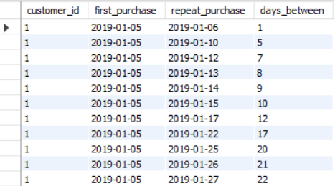
Task 8: Identifying Repeat Customers
SQL Query
-- Step 1: Self-join to find purchase pairs within 30 days
SELECT
a.customer_id,
a.date AS first_purchase,
b.date AS repeat_purchase,
DATEDIFF(b.date, a.date) AS days_between
FROM walmart_sales a
JOIN walmart_sales b
ON a.customer_id = b.customer_id
AND b.date > a.date
AND DATEDIFF(b.date, a.date) <= 30
GROUP BY a.customer_id, a.date, b.date
ORDER BY a.customer_id, a.date;

Slide 9
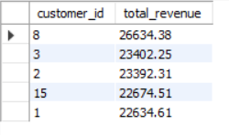
Task 9: Finding Top 5 Customers by Sales Volume
SQL Query
-- Step 1: Calculate total revenue per customer
SELECT
customer_id,
ROUND(SUM(total), 2) AS total_revenue
FROM walmart_sales
GROUP BY customer_id
ORDER BY total_revenue DESC
LIMIT 5; -- Only top 5 customers

Slide 10
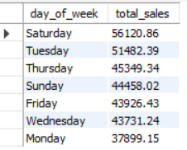
Task 10: Analyzing Sales Trends by Day of the Week
SQL Query
-- Step 1: Add weekday column using DAYNAME()
SELECT
DAYNAME(date) AS day_of_week,
ROUND(SUM(total), 2) AS total_sales
FROM walmart_sales
GROUP BY day_of_week
ORDER BY total_sales DESC;

Slide 11
Video link___ https://drive.google.com/file/d/1hxjY5jN56Uj7oov6owDkUJT6Q8Ckc0PU/view?usp=sharing

